Slide 1

LEX/FLEX
Scanner Generator in C

Slide 2

Project Title
Presented By
Student Name: Student ID:
Mohamed yasser 200013244
Momen Ashraf 200013269
Nader Mamdouh 200013285
Eman Khaled 200013190
Shahd Hatim 200018584
Under Supervision
Name of Doctor: Nehal A. Mohammed
Name of T. A.: Toka abdelhamid

Slide 3
Outline
Introduction
Phases of Compiler
Lexical Analyzer
Software Tools
Inputs of Scanner
Outputs of Scanner
Conclusion
References

Slide 4
Introduction
Compiler design is an exciting field at the intersection of computer science and software engineering that focuses on creating programs that translate source code written in a high-level programming language into machine code that computers can execute.
A compiler is a software tool that translates high-level programming languages (such as: C, Java, or Python) into machine code or an intermediate representation. This translation process involves several stages and transformations.

Slide 5
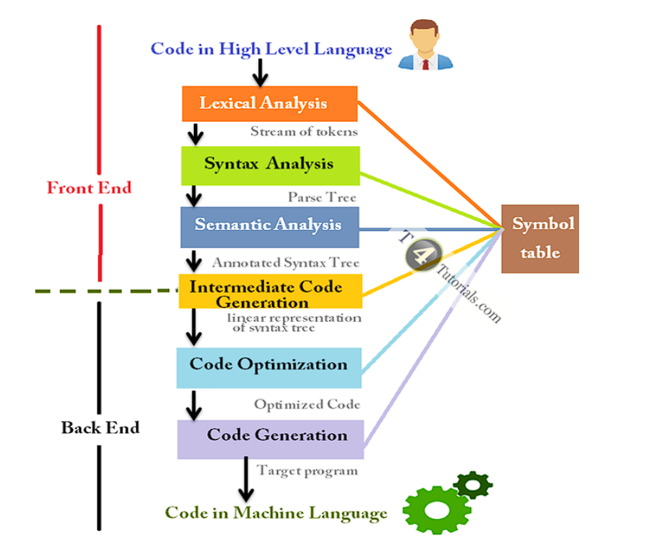
Phases of Compiler
Lexical Analysis (Scanning): This phase involves breaking the source code into tokens.
Syntax Analysis (Parsing): This phase involves analyzing the structure of the source code based on the rules of the programming language's grammar.
Semantic Analysis: This phase checks the source code for semantic correctness.
Intermediate Code Generation: In this phase, the compiler translates the source code into an intermediate representation.
Code Optimization: This phase involves improving the intermediate code to make it more efficient.
Code Generation: This phase translates the optimized intermediate code into the target machine language or bytecode.

Slide 6
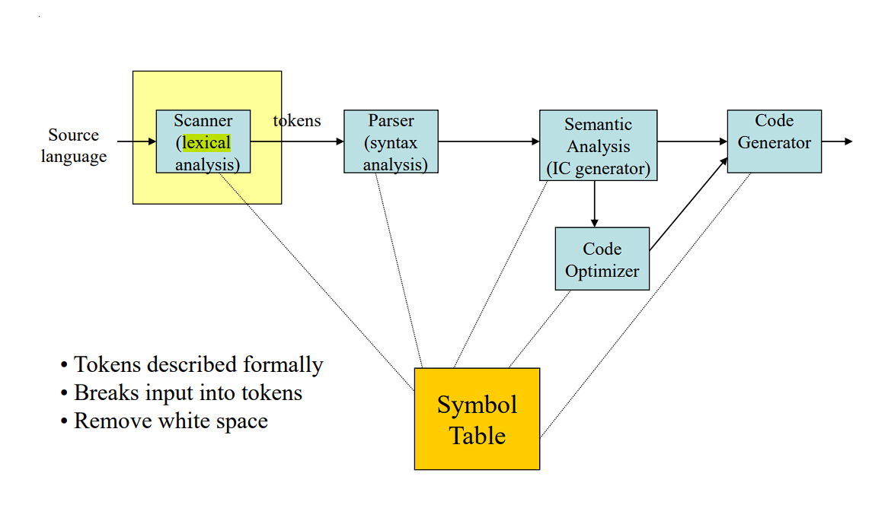

Lexical Analyzer
The lexical analyzer (also called the scanner) groups the characters making up the source program into meaningful sequences called lexemes.
The lexemes are mapped into tokens of the form :
<token_name , attribute_vlaue>
The tokens in the above form are used later by the syntax analyzer.
The token_name is an abstract symbol that tells the kind of the lexeme, e.g. ID, +, * , if, 60, etc.
The attribute_value points to an entry in the symbol table for this token.

Slide 7
Software Tools
TINY compiler: is a simple programming language designed for educational purposes.
Flex Software: is a powerful tool for generating lexical analyzers (scanners) for programming languages.
C-Minus Language: A more extensive language than Tiny, It is a simple subset of the C programming language, designed for educational purposes.

Slide 8
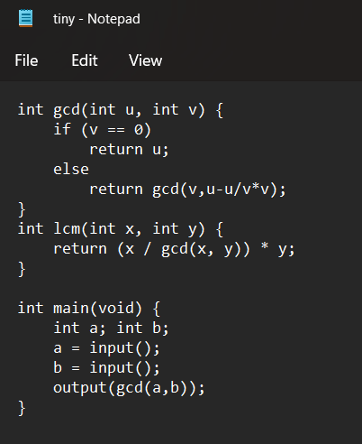
Inputs of Scanner:

Slide 9
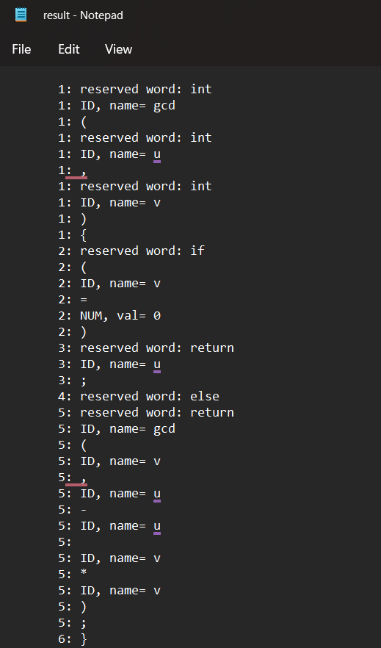
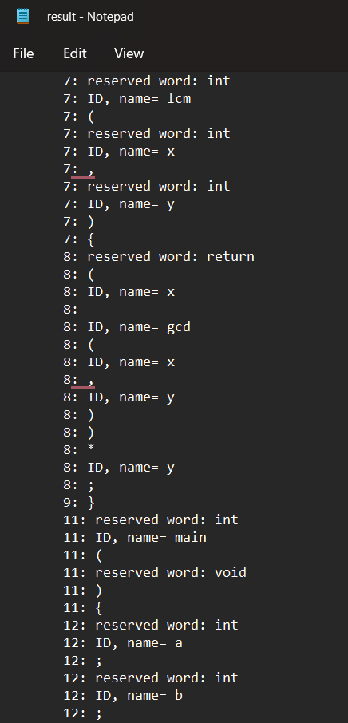
Outputs of Scanner

Slide 10
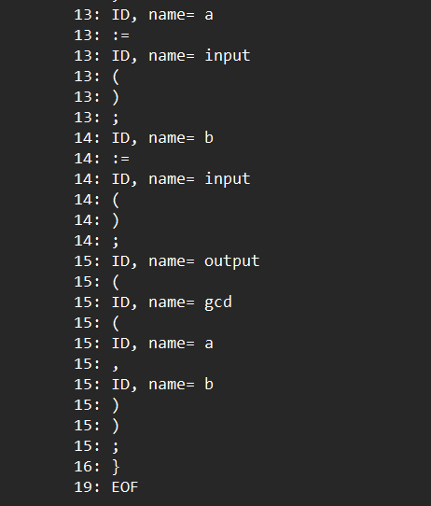
Outputs of Scanner cont.

Slide 11
Conclusion
compilers and lexical analyzers are essential for software development, translating high-level code into machine-readable instructions. Compilers meticulously process code through various stages, ensuring efficient execution across platforms. Meanwhile, lexical analyzers break down source code into tokens, facilitating this process. Together, they enable programmers to express complex logic, driving innovation in the digital sphere.

Slide 12
References:
AI Tools
Lectures
Sections
https://www3.nd.edu/~dthain/compilerbook/compilerbook.pdf

Slide 13


